Slide 1

Data Analysis Using SQL and Excel
Lect. 2

Slide 2
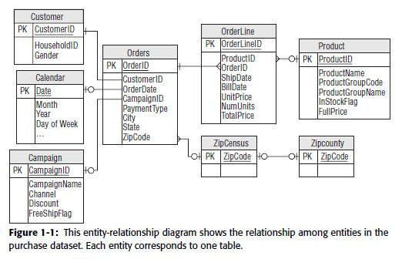

Slide 3
How Different Is Different?
Chapter 3

Slide 4
How Different Are the Averages?
The retail purchase data has purchases from all fifty states, and then some.
This section addresses the question of whether the average purchase amount
(in the column TOTALPRICE) differs in different states. Statistics answers this question, and most of the calculations can be done using SQL queries.

Slide 5
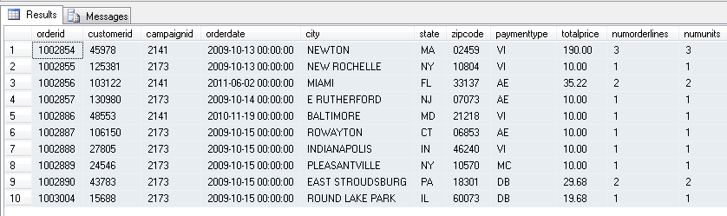
2 Lab. Data
SELECT TOP 20 * FROM [sqlbook].[dbo].[orders]

Slide 6
SQL 1.
SELECT AVG(totalprice),COUNT(1),state FROM orders o
WHERE o.state IN ('CA', 'NY')
GROUP BY state
85.4845 17839 CA
70.1407 53537 NY
SQL 2.
SELECT AVG(totalprice),COUNT(1) FROM orders o
WHERE o.state IN ('CA', 'NY')
73.9755 71376

Slide 7
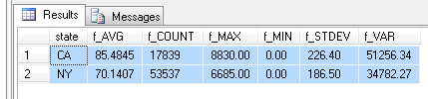
SQL 3.
SELECT state, AVG(totalprice) f_AVG, COUNT(1) f_COUNT ,
MAX(totalprice) f_MAX ,MIN(totalprice) f_MIN ,
CAST(STDEV(totalprice) AS DECIMAL(9,2)) f_STDEV , CAST( VAR(totalprice) AS DECIMAL(9,2)) f_VAR
FROM orders o
WHERE o.state IN ('CA', 'NY')
GROUP BY state

Slide 8
SQL 4.
SELECT 5*FLOOR(totalprice/5),
SUM(CASE WHEN state = 'CA' THEN 1 ELSE 0 END) as CA,
SUM(CASE WHEN state = 'NY' THEN 1 ELSE 0 END) as NY
FROM orders o
WHERE o.state IN ('CA', 'NY')
GROUP BY 5*FLOOR(totalprice/5)
F03-04. A histogram which has the averages for each state in the legend. Visually, the two histograms look quite similar, suggesting that the average sizes for each state might well be within the margin of error. However, the analysis is not yet complete.

Slide 9
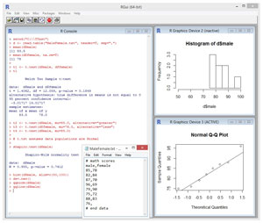
Fundamentals of T-Test Using R

Slide 11
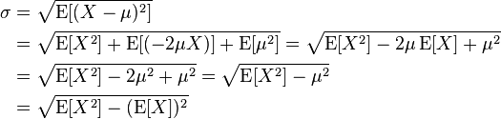
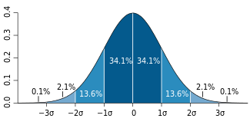
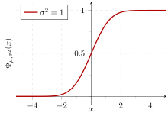
Variance
Standard deviation
A plot of a normal distribution (or bell-shaped curve) where each band has a width of 1 standard deviation
Cumulative probability of a normal distribution with expected value 0 and standard deviation 1

Slide 12
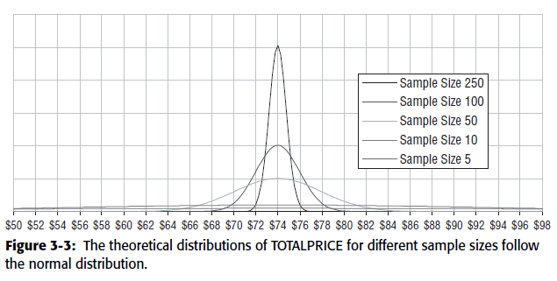
Central Limit Theorem
Consider the average TOTALPRICE of ten orders taken randomly. If this
process is repeated, the averages approximate a normal distribution. If instead
we were to take one hundred orders repeatedly rather than ten, the averages also
follow a normal distribution, but one whose standard deviation is a bit smaller.
As the size of the samples increases, the distribution of the average forms a narrower
band around the actual average in the original data. Figure 3-3 shows some
distributions for the average value of TOTALPRICE for different sized groups
coming from the California–New York orders.

Slide 13
What is the likelihood that taking the average of 17,839 values randomly
chosen from the population results in an average of $85.48 and taking a sample of
53,537 values results in $70.14?
The first approach is to treat the orders as two samples from the same population
and ask a question that is perhaps now familiar: What is the likelihood that
the differences are due just to random variation?

Slide 14

Estimation Based on Two Samples
There are 71,376 orders in New York and California, with an average order size of $73.98 and a standard deviation of $197.23. The orders from California are a subgroup of this population, comprising 17,839 orders with an average order size of $85.48. What is the confidence that this subgroup is just a random sample pulled from the data (meaning that the observed difference is due only to chance)?
As mentioned earlier, the standard deviation of the sample average is the
standard deviation of the overall data divided by the square root of the sample
size. For instance, the 17,839 orders from California constitute a sample from
the original population. Based on the overall data the average expected value
should be $73.98 and the standard deviation $197.23 divided by the square
root of 17,839, which is about $1.48.
Standard deviation of the mean
=2*MIN(1-NORMDIST(85.14; 73.98; 1.48; 1); NORMDIST(85.14; 73.98; 1.48; 1))

Slide 15
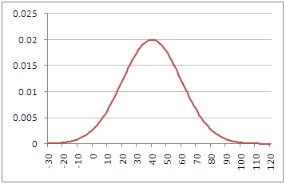

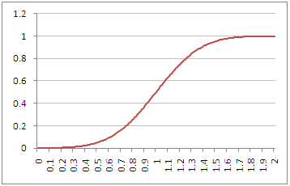
Normdist Function Examples Example 1 - Normal Probability Density Function The chart on the right shows the the Normal Probability Density Function with a mean of 40 and a standard deviation of 20. If you want to calculate the value of this function at x = 50, this can be done using the Excel Normdist function, as follows: =NORMDIST( 50, 40, 20, FALSE ) This gives the result 0.017603266. | Normal Probability Density Function with mean = 40, std. dev. = 20
Example 2 - Cumulative Normal Distribution Function The chart on the right shows the the Cumulative Normal Distribution Function with a mean of 1 and a standard deviation of 0.3. If you want to calculate the value of this function at x = 0.8, this can be done using the Excel Normdist function, as follows: =NORMDIST( 0.8, 1, 0.3, TRUE ) This gives the result 0.252492538. | Cumulative Normal Distribution Function with mean = 1, std. dev. = 0.3
=2*MIN(1-NORMDIST(85.14; 73.98; 1.48; 1); NORMDIST(85.14; 73.98; 1.48; 1))

Slide 16
What is the probability that a random sample’s average value is at least as far from the overall average as the observed sample average?
=2*MIN(1-NORMDIST(85.14; 73.98; 1.48; 1); NORMDIST(85.14; 73.98; 1.48; 1))
In statistics, the p-value is a function of the observed sample results (a statistic) that is used for testing a statistical hypothesis. Before performing the test a threshold value is chosen, called the significance level of the test, traditionally 5% or 1% and denoted as α. If the p-value is equal to or smaller than the significance level (α), it suggests that the observed data are inconsistent with the assumption that the null hypothesis is true, and thus that hypothesis must be rejected and the alternative hypothesis is accepted as true. When the p-value is calculated correctly, such a test is guaranteed to control the Type I error rate to be no greater than α.
The p-value is calculated as the lowest α for which we can still reject the null hypothesis for a given set of observations. An equivalent interpretation is that p-value is the probability of obtaining the observed sample results, or a "more extreme" result, when assuming the null hypothesis is actually true (where "more extreme" is dependent on the way the hypothesis is tested). Since p-value is used in Frequentist inference (and not Bayesian inference), it does not in itself support reasoning about the probabilities of hypotheses, but only as a tool for deciding if to move from the null hypothesis to the alternative hypothesis.

Slide 17
In statistics, the standard score is the (signed) number of standard deviations an observation or datum is above the mean.
Another way of looking at this is using the z-score, which measures the
distance from the average to the observed value, in multiples of standard
deviations. The expression to calculate the z-score is ($84.48 – $73.98)/$1.48,
which comes to 7.8 standard deviations away. That is a long way away, and
it is very, very, very unlikely that the average order size for California is due
to nothing more than chance.

